Slide 1
Modeling Virtually Real Appearance

Slide 2
Modeling Virtual Reality
Modeling appearance of an object in virtual reality involves working on the following aspects:
Material characteristics
Lighting
Shading
Textures

Slide 3
Phong Reflection Model
The Phong reflection model is a local illumination model in which the light coming off of an object is grouped into one of the following categories:
Ambient reflection
This part of the model defines how the material reflects light from an ambient source
Three coefficients of the material kar; kag; kab are provided
The values of the coefficients tell how much amounts of the red, green, and blue light components are reflected

Slide 4
Diffuse reflection
Defines reflections of red, green, and blue components of light from the surface as a dull material
The color given here will be reflected with dull appearance
Amount of reflected light will depend upon the strength and distance of light source

Slide 5
Specular reflection
Amount of the reflected red, green, and blue components as if the surface was shiny
Intensity of reflected light depends upon the direction of light and the direction of line of sight
A shininess coefficient has to defined as a property of the material
Water and glass are example of such surfaces

Slide 6
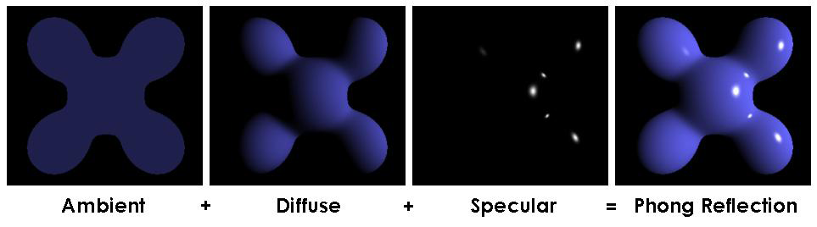
Components of Phong reflection model

Slide 7
Appearance of Materials
Specular surfaces
Smooth and shiny
Reflect most of the light incident on them
Mirrors are perfectly specular surfaces
Diffuse surfaces
Rough and dull
Scatter light in all directions
A perfectly diffuse surface scatters lights equally in all directions and appear the same from all directions

Slide 8
Appearance of Materials
Translucent surfaces
Allow some light to pass through
Other objects can be seen through them
Some light may also get reflected
Water and glass are example of such surfaces
Ambient color: Color of a material when it is in shadow

Slide 9
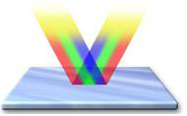
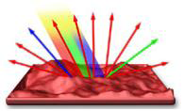
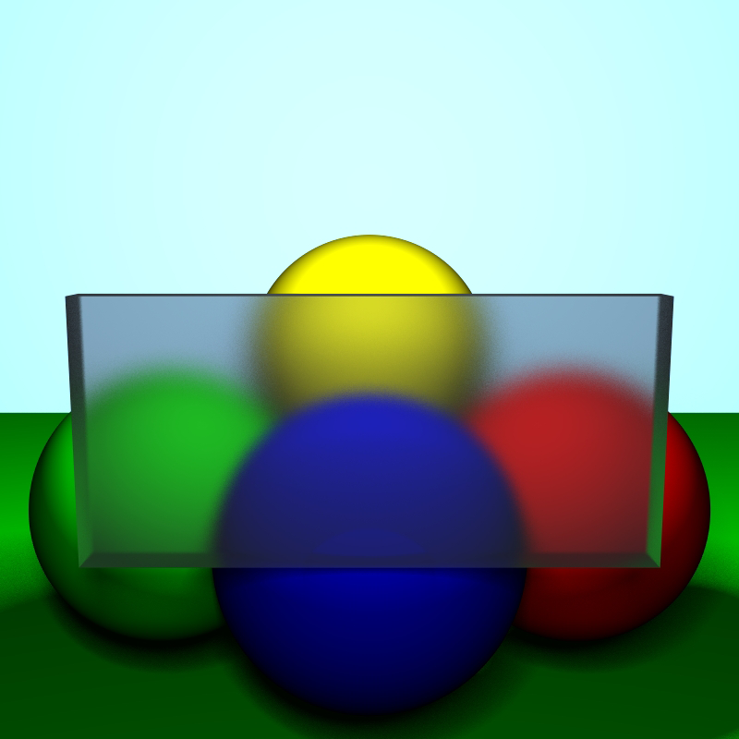
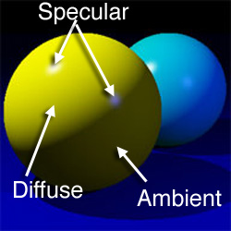
(a) Specular surface
(b) Diffuse surface
(c) Traslucent surface
(d) Ambient, diffuse, and specular
colors

Slide 10
Material Modeling with OpenGL
The reflection parameters of a material can be provided in form of three arrays of four values each
The arrays contain values for ambient, reflection parameters of a material can be provided in form of three arrays of four values each e.g.
GLfloat ambient[] = {r, g, b, a};
GLfloat diffuse[] = {r, g, b, a};
GLfloat specular[] ={r, g, b, a};

Slide 11
Material Fv in OpenGL calculates the amount of light reflected from a surface, considering the viewing angle and surface properties.
This simulates how materials reflect light at different angles, enhancing scene realism.

Slide 12
These arrays can be applied to a model using a material function, e.g.
glMaterialfv(face, property, value)
The face could be GL_FRONT, GL_BACK, or GL_FRONT_AND_BACK
The property will be GL_AMBIENT, GL_DIFFUSE, or GL_SPECULAR when the arrays ambient, diffuse, or specular, respectively, are provided
The material function may be called repeatedly to apply more properties
GL_SHININESS can be given in property with a positive float value to increase specular effect

Slide 13
glMaterialfv(face, property, value)
face GL_FRONT, GL_BACK, or GL_FRONT_AND_BACK
property GL_AMBIENT, GL_DIFFUSE, or GL_SPECULAR

Slide 14
Light Sources
Different light sources make the same object appear differently
Ambient Light
Light sources causing uniform illuminations
Same amount of light reaches all points of the scene
Light bulbs with rough covers on them are examples of ambient lights

Slide 15
Point (Diffuse) light sources
Light source that emits light equally in all directions
Intensity of light decreases with distance from
Size of the source is usually small
Spotlight
Light is distributed in shape of cone
Most of the light is concentrated in the center of the cone

Slide 16
Distant light
The light source is considered at a large distance from the scene
Rays of light become parallel to each other
Colored light
The light can have a color
The color is represented in the red, green, and blue components of the light definition

Slide 17

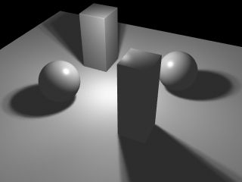
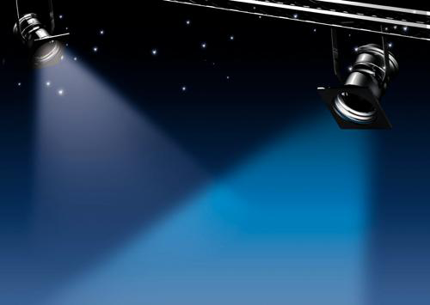
(a) Ambient lights
(b) Point light
(c) Spot lights

Slide 18
Shading
Light coming from different sources can give rise to a different shades of color on a homogenously colored same surface.
The change of appearing color depends upon the type of light source and the direction from which the light falls on an object
Flat shading
A three dimensional surface is divided into polygons
Each polygon is shaded with a color depending upon its status with respect to the light source

Slide 19
Smooth shading
Amount of shade is computed at vertices of surface meshes or some points inside these meshes (polygons)
Colors for the points in between the computed points is determined using interpolation
Using OpenGl the smooth or flat shading can be enabled using
glShadeModel(mode)
where mode can be GL_FLAT or GL_SMOOTH

Slide 20
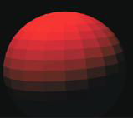
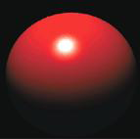
(a) Flat shaded
(b) Smooth shaded

Slide 21
Implementation Material Modeling
#include <GL/glut.h>
void init() {
glEnable(GL_DEPTH_TEST);
glEnable(GL_LIGHTING);
glEnable(GL_LIGHT0);
// Set up a white light source
GLfloat light_position[] = {1.0f, 1.0f, 1.0f, 0.0f};
GLfloat light_diffuse[] = {1.0f, 1.0f, 1.0f, 1.0f};
glLightfv(GL_LIGHT0, GL_POSITION, light_position);
glLightfv(GL_LIGHT0, GL_DIFFUSE, light_diffuse);

Slide 22
// Set material properties
GLfloat ambientColor[] = {0.2f, 0.2f, 0.2f, 1.0f};
GLfloat diffuseColor[] = {0.8f, 0.8f, 0.8f, 1.0f};
GLfloat specularColor[] = {1.0f, 1.0f, 1.0f, 1.0f};
GLfloat shininess = 64.0f;
glMaterialfv(GL_FRONT, GL_AMBIENT, ambientColor);
glMaterialfv(GL_FRONT, GL_DIFFUSE, diffuseColor);
glMaterialfv(GL_FRONT, GL_SPECULAR, specularColor);
glMaterialf(GL_FRONT, GL_SHININESS, shininess);
}

Slide 23
void display()
{
glClear(GL_COLOR_BUFFER_BIT | GL_DEPTH_BUFFER_BIT);
glutSolidTeapot(1.0); // Example object (teapot)
glutSwapBuffers();
}

Slide 24
int main(int argc, char** argv)
{ glutInit(&argc, argv);
glutInitDisplayMode(GLUT_RGBA | GLUT_DOUBLE | GLUT_DEPTH);
glutCreateWindow("Material Modeling Example");
glutDisplayFunc(display);
init();
glutMainLoop();
return 0;
}

Slide 25
Select which light property will be applied on a View in where we have a street Light view and a light is covered with a rough surface.
Also define the c++ function that will be used to perform this task.

Slide 26
The next we have another example.

Slide 27
Applying Lightning
#include <GL/glut.h>
void init() {
// Enable lighting, light source, and depth testing
glEnable(GL_LIGHTING);
glEnable(GL_LIGHT0);
glEnable(GL_DEPTH_TEST);
// Define light properties
GLfloat light_position[] = { 0.0f, 0.0f, 10.0f, 1.0f }; // Position of the light (positional)
GLfloat light_ambient[] = { 0.2f, 0.2f, 0.2f, 1.0f }; // Ambient light
GLfloat light_diffuse[] = { 1.0f, 1.0f, 1.0f, 1.0f }; // Diffuse light (bright white)
GLfloat light_specular[] = { 1.0f, 1.0f, 1.0f, 1.0f }; // Specular light (shiny reflection)
// Set the light properties
glLightfv(GL_LIGHT0, GL_POSITION, light_position);
glLightfv(GL_LIGHT0, GL_AMBIENT, light_ambient);
glLightfv(GL_LIGHT0, GL_DIFFUSE, light_diffuse);
glLightfv(GL_LIGHT0, GL_SPECULAR, light_specular);

Slide 28
Applying Material properties
// Define material properties
GLfloat mat_ambient[] = { 0.2f, 0.2f, 0.2f, 1.0f }; // Ambient material color
GLfloat mat_diffuse[] = { 0.8f, 0.5f, 0.3f, 1.0f }; // Diffuse material color
GLfloat mat_specular[] = { 1.0f, 1.0f, 1.0f, 1.0f }; // Specular material color
GLfloat mat_shininess[] = { 50.0f }; // Shininess of the material
// Apply material properties
glMaterialfv(GL_FRONT, GL_AMBIENT, mat_ambient);
glMaterialfv(GL_FRONT, GL_DIFFUSE, mat_diffuse);
glMaterialfv(GL_FRONT, GL_SPECULAR, mat_specular);
glMaterialfv(GL_FRONT, GL_SHININESS, mat_shininess);
// Set the background color to dark gray
glClearColor(0.1f, 0.1f, 0.1f, 1.0f);
// Set up the perspective projection
glMatrixMode(GL_PROJECTION);
glLoadIdentity();
gluPerspective(45.0, 1.0, 1.0, 100.0);
glMatrixMode(GL_MODELVIEW);
}

Slide 29
int main(int argc, char **argv) {
glutInit(&argc, argv);
glutInitDisplayMode(GLUT_DOUBLE | GLUT_RGB | GLUT_DEPTH);
glutCreateWindow("Light and Material Setup");
init(); // Initialize lighting and material properties
glutMainLoop();
return 0;
}

